Slide 1
301 Oct 24, Class 17
Experiment 2 Writing Overview
  Multi-experiment reporting
Assefi & Gary (2003)

Slide 2
Experiment 2 methods
Participants
  Two sections of Research Methods recruited participants
  132 participants provided data.
Materials
  Use the images to illustrate the stimuli with a Figure
  Do not forget the caption/note for this Figure as well
Procedure
  40 items studied for 4s each
  Deep encoding just as Experiment 1
  Shallow encoding: For each picture, indicate which colors of the five listed below are most prominent in the image
    1 = black or gray, 2 = red or brown, 3 = blue or purple, 4 = green or pink, 5 = yellow or white
  40-tiem Recognition test was based on 2AFC with one old and one new/lure/foil

Slide 3
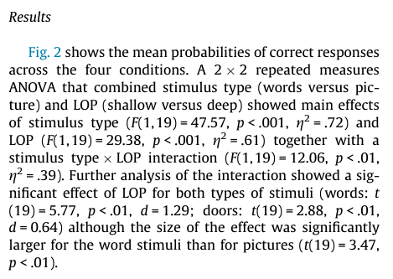
Post-hoc t-tests for Experiment 2
Targeted comparisons
  Deep vs Shallow for just Abstract stim
    t(df) = X.XX, p<.0y
  Deep vs Shallow for just Meaningful stim
    t(df) = X.XX, p<.0y
Tukey test
  Runs all possible contrasts
  Adjusts for “multiple comparisons”

Slide 4
R code for analysis
anova_result = ezANOVA(
exp2
, dv = .(Recognition)
, wid = .(P)
, within = NULL # NULL if no within factors
, between = .(Depth, Stimulus) # NULL if no between factors
, observed = NULL
, diff = NULL
, reverse_diff = FALSE
, type = 3
, white.adjust = FALSE
, detailed = FALSE
, return_aov = FALSE # TRUE for showing details
)
print(anova_result)
just_abstract = subset(exp2,
exp2$Stimulus == "abstract")
t.test(Recognition ~ Depth,
just_abstract, var.equal = TRUE)
just_meaningful = subset(exp2,
exp2$Stimulus == "meaningful")
t.test(Recognition ~ Depth,
just_meaningful, var.equal = TRUE)

Slide 5
Writeup #2
Include both Experiment 1 and Experiment 2
  Methods for Experiment 2 available on Canvas
  Make corrections to Experiment 1
Expand the Introduction
  What is “deep” encoding?
  Why do we hypothesize that “deep” encoding leads to better memory?
  What is new about the studies you are reporting?
Expand the Discussion
  Summarize results of both experiments
  What do they mean with respect to the hypothesis?
    Refer back to theory from the Introduction

Slide 6
APA Report Sections
Abstract
  Very concise summary, ~200 words
Introduction
  Construct, background, hypothesis
Methods
  Participants, materials, procedure
Results
  Figure
Discussion
  Conclusion, interpretation, limitations
References
Repeat as necessary with segue paragraphs between

Slide 7
Writeup #2
Abstract
Introduction
Experiment 1
  Method
  Results (Figure 1)
  Discussion (short, segue)
Experiment 2
  Method (Figure 2)
  Results (Figure 3)
  Discussion (optional)
General Discussion
  Limitations, applications of findings across studies
References

Slide 8
Absolut Memory Distortions
Can the simple suggestion that you have consumed alcohol affect your memory for an event? Alcohol placebos affect social behaviors, but not non-social ones, and have not previously been shown to affect memory. We investigated the effect of alcohol placebos using materials that revealed both the social and the nonsocial influences of memory. Subjects drank plain tonic water, but half were told it was a vodka and tonic; then all subjects took part in an eyewitness memory experiment. Subjects who were told they drank alcohol were more swayed by misleading postevent information than were those who were told they drank tonic water, and were also more confident about the accuracy of their responses. Our results show that the mere suggestion of alcohol consumption may make subjects more susceptible to misleading information and inappropriately confident. These results also provide additional confirmation that eyewitness memory is influenced by both nonsocial and social factors.

Slide 9
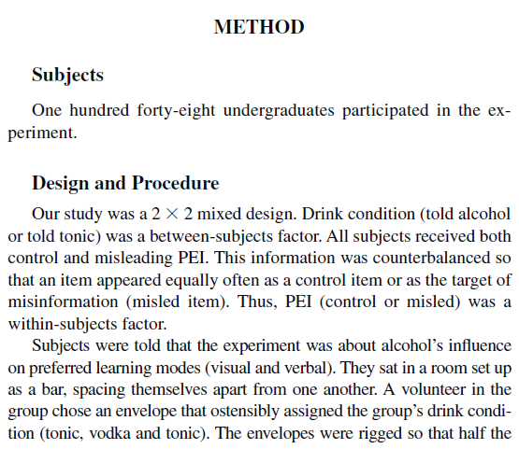
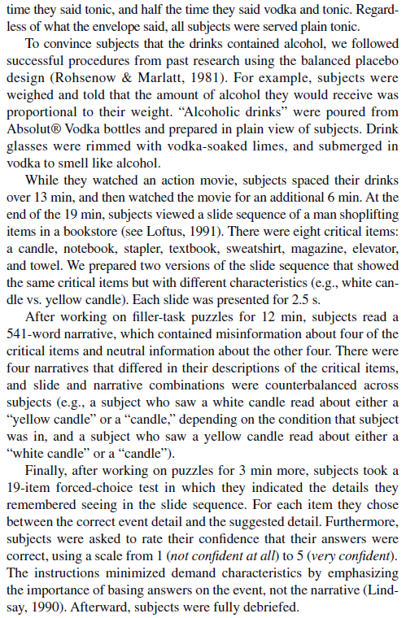

Slide 10
Assignment questions
What are the two factors and levels of each factor in the design?
What is the main dependent variable of the design?
What are the 3 hypotheses tested by this factorial design?
What kind of interaction is shown in Figure 1?

Slide 11
Diagram
2x2 mixed design
  Placebo/control between groups
  Misleading/control information within groups
148 original participants (31 eliminated)
  74 subjects per group planned
 | Misleading PEI | Control PEI
Alcohol placebo | N=74 1.45 | N=74 2.45
Control | N=74 1.80 | N=74 2.50

Slide 12
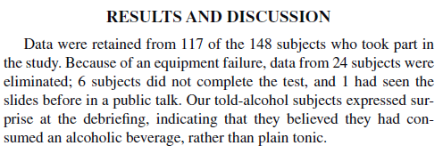
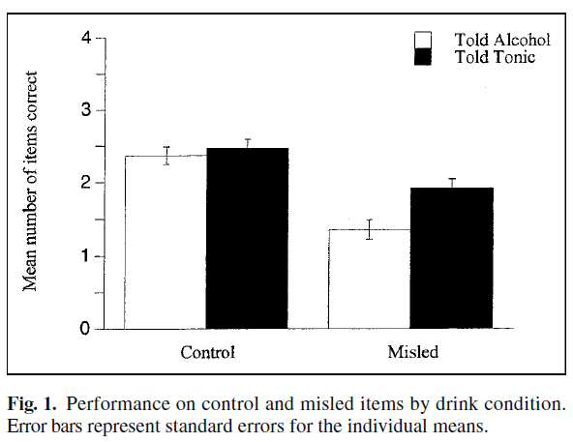

Slide 13
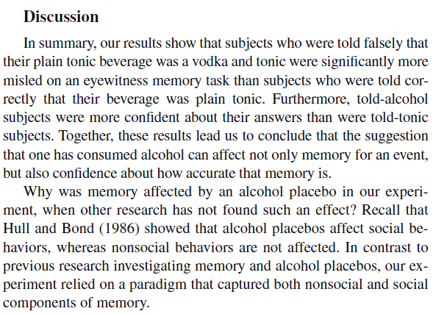

Slide 14
For Monday 10/27
Operations Manual Chapter 7: Preparing a Research Proposal
  Finding a group
  Initial brainstorming ideas
    Submit first idea by Tuesday evening (late submissions accepted)
Reading #8 Salovich, Mason & Rapp (2025)
  Brief questions on Canvas

